Slide 1
Unit 3 :
Physical Database Design
Databases

Slide 2
UNIT 3: PHYSICAL DESIGN OF DATABASES
Physical characteristics of database storage
Graphical tools for database implementation.
The data definition language.
Creation, modification and deletion of databases.
Type of data. Values. Operators
Table management
6.1 Syntax of the CREATE TABLE statement
6.2 Table properties
6.3 Modification of tables
6.4 Deleting tables
Views
The data control language
Users and privileges

Slide 3
8. The DCL language
The DCL language is the subset of SQL statements dedicated to data control, fundamentally to control access to it. Some of these instructions are:
User and privilege management:
CREATE USER
DROP USER
GRANT
REVOKE
Backup management:
LOAD DATA LOCAL INFILE
Carrying out safe operations:
LOCK TABLES
UNLOCK TABLES

Slide 4
9. Users and privileges
The MySQL server has an administration database called mysql mounted . In that database there are several tables related to user access control. Of them the most important are:
user
db
proc
columns_priv
tables_priv
procs_priv
To manage user access control we could appropriately modify the content of these tables, but we are not going to do it this way but through commands or instructions.

Slide 5
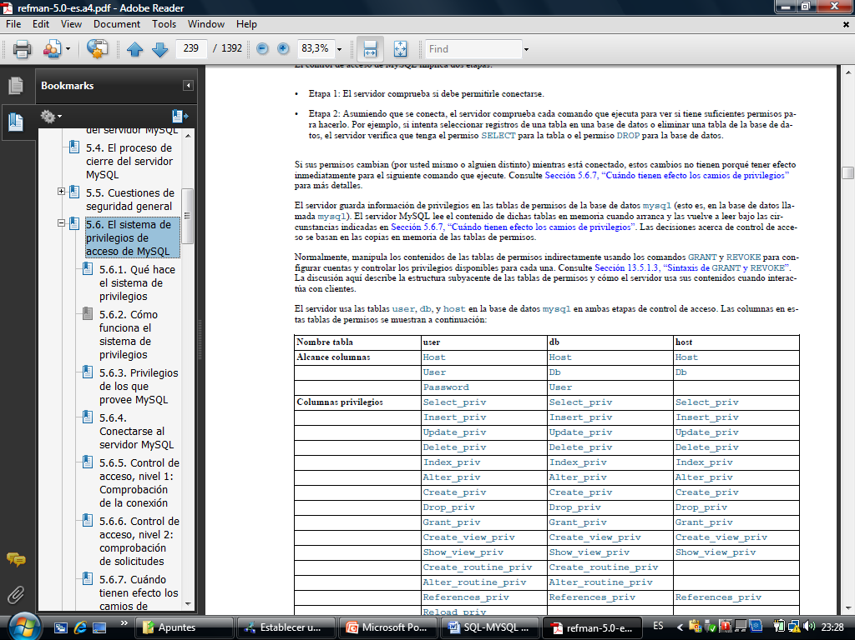
9. Users and privileges
These are some of the columns in the user and db tables:

Slide 6
9. Users and privileges
A MySQL user account is defined in terms of a username and the computer or computers from which the user can connect to the server. The account also has a password. It gives access to the objects of the databases mounted on the server according to a privilege system.
Accounts can be added in three ways:
Using the GRANT command
user table of the administration database.
Using the CREATE USER command .

Slide 7
9. Users and privileges
CREATE USER SYNTAX
CREATE USER account [IDENTIFIED BY password ];
The account name must contain the username , the ' @ ' character , and the name of the computer from which you are authorized to connect to the account. For example, a valid account name that you have been working with in all sessions is:
'root'@'localhost'
IDENTIFIED is used to specify a password.
Multiple accounts can correspond to one username.
When you create an account with CREATE USER , the account does not have any privileges except to establish a connection. The privileges will have to be granted later with the GRANT command .

Slide 8
9. Users and privileges
Example: Create a user account Jorge to connect from PC05, another to connect from all computers on the 10.0.13.0/24 network and another account for Ana to connect from any computer.
CREATE USER 'jorge'@'pc05' IDENTIFIED BY '1234';
CREATE USER 'jorge'@'10.0.13.%' IDENTIFIED BY '1234';
CREATE USER 'ana'@'%';
IMPORTANT: The '%' character is a wildcard that represents any set of characters. You can also use the '_' character as a wildcard that replaces a single character.

Slide 9
9. Users and privileges
Modify user password:
To modify a user's password, the mysqladmin client program can be used . The UPDATE command can also be used to modify the password column in the user table . The mysqladmin program is used to do many other things. In particular, to allow modification of a user account, the following must be used:
Mysqladmin –u user - p password New Password _
mysqladmin -u user_name -h host_name password " password "
mysql database and execute something like this:
UPDATE user SET password =PASSWORD('4444dddda') WHERE User =' root ';
ALTER USER ' jeffrey '@'localhost' IDENTIFIED BY ' password ';
https://dev.mysql.com/doc/refman/5.7/en/assigning-passwords.html _

Slide 10
9. Users and privileges
Delete an account:
To delete an account the DROP USER statement can be used. The syntax of DROP USER is:
DROP USER account;
For example:
DROP USER 'JORGE'@'PC05';

Slide 11
9. Users and privileges
GRANT SYNTAX: Granting privileges so that users can use database objects
GRANT private_type [( column_list )] [, …… ] ON { table | * | *.* | database.* } TO user [IDENTIFIED BY [PASSWORD] ' password '] [, user [IDENTIFIED BY [PASSWORD] ' password ']] ... [WITH [GRANT OPTION | MAX_QUERIES_PER_HOUR count | MAX_UPDATES_PER_HOUR count | MAX_CONNECTIONS_PER_HOUR count | MAX_USER_CONNECTIONS count ]]
Multiple privileges can be granted in the same statement by separating them with commas. The following slide lists the types of privileges that can be used.
If a privilege affects columns of a table, their names will be written, after the type of privilege, in parentheses and separated with commas.
The ON clause {table | * | *.* | database_data.*} , allows you to grant privileges at global, database or table levels.

Slide 12
9. Users and privileges
TYPES OF PRIVILEGES:
Privilege | Meaning
ALL [PRIVILEGES] | Activate all privileges except GRANT OPTION.
ALTER | Allows the use of ALTER TABLE .
CREATE | Allows the use of CREATE TABLE .
CREATE ROUTINE | Create stored routines.
DELETE | Allows the use of DELETE .
DROP | Allows the use of DROP TABLE .
EXECUTE | Allows the user to execute stored procedures.
INDEX | Allows the use of CREATE INDEX and DROP INDEX .
INSERT | Allows the use of INSERT .
SELECT | Allows the use of SELECT .
UPDATE | Allows the use of UPDATE .
USAGE | Synonym of "without privileges."
GRANT OPTION | Allows you to grant privileges.

Slide 13
9. Users and privileges
GRANT PRIVILEGES
For a table, the privileges that can be used are SELECT, INSERT, UPDATE, DELETE, CREATE, DROP, GRANT OPTION, INDEX, and ALTER
For columns, the privileges that can be used are SELECT and UPDATE.
When ALL is used in the privilege type, the existing privileges for the level in question are assigned (global, database, table). You cannot set ALL on columns.
If a privilege is assigned globally, it cannot be removed or removed individually. For example, if the SELECT privilege is given globally, it cannot be removed for a database, neither for a table nor for a column. If a SELECT privilege is given for a table, it cannot be removed for a column in that table.
The WITH GRANT OPTION clause grants the corresponding user the ability to grant the received permissions to other users.

Slide 14
9. Users and privileges
Example 1: Establish that the account that authorizes Pedro to access from all computers whose name begins with PC has privileges to perform queries on all CUSTOMERS columns and to modify ID , first name and last name in the CUSTOMERS table.
If the account ' pedro ' @ 'pc %' does not exist, the account is created when the statement is executed.
GRANT update ( ID, name, surname ), select ON rentals.clientes TO ' pedro '@ 'pc %' IDENTIFIED BY '1234';

Slide 15
9. Users and privileges
Example 2: Establish in the previous account a global query privilege, a privilege to perform any operation in the COURSE database, and a privilege to create and delete tables in the test database, being able to assign this privilege.
GRANT select ON * .* TO pedro'@ 'pc %' IDENTIFIED BY '1234';
GRANT all ON course.* TO ' pedro'@ 'pc %' ;
GRANT create , drop ON test.* TO ' pedro'@ 'pc %' WITH GRANT OPTION;

Slide 16
9. Users and privileges
REVOKE SYNTAX: Withdrawal of privileges
Only privileges that have been granted directly can be withdrawn. To remove all privileges from a user:
REVOKE priv_type [( columns )] [, priv_type [( columns )]] ... ON { table | * | *.* | database .*} FROM user [, user ] ...
REVOKE ALL PRIVILEGES, GRANT OPTION FROM user;

Slide 17
9. Users and privileges
SHOW GRANTS SYNTAX: Show account privileges
Example: Show the privileges of the previously used account:
SHOW GRANTS FOR user;
SHOW GRANTS FOR ' pedro '@ 'pc %';

